Slide 1
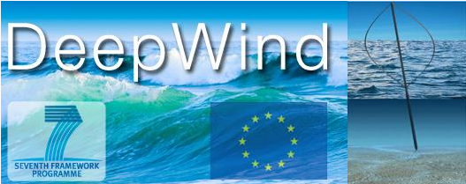
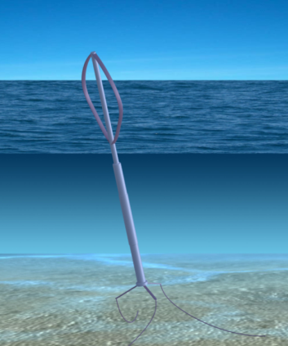
Concept design
Concept in Brief:
Radical novel wind turbine concept
Easy installation & Inexpensive operation
20GWh/yr energy production
Wind direction insensitive
Simple competitive concept stall controls and rpm limit
Few components, high reliability and safety
Scalable Multi-MW concept
100Ton/MW floater design
COE ~20€/MWh
Design tools for 1-20,000 kW
Uwe Schmidt Paulsen uwpa@dtu.dk

Slide 2
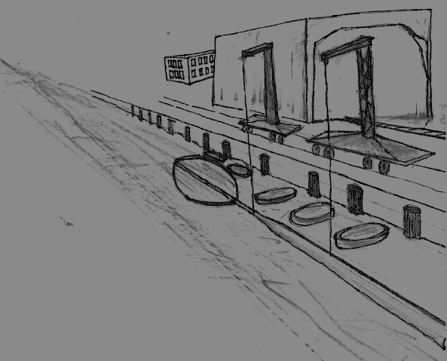
Yard Manufacturing
Main DeepWind parts are manufactured at yard.
Assembling of part & sub components.
The structure is made watertight.
Yard cranes deploy the turbine for embarquement preparations.

Slide 3
Towing to site
A tug boat tows the DeepWind turbine from port of embarquement to site.

Slide 4
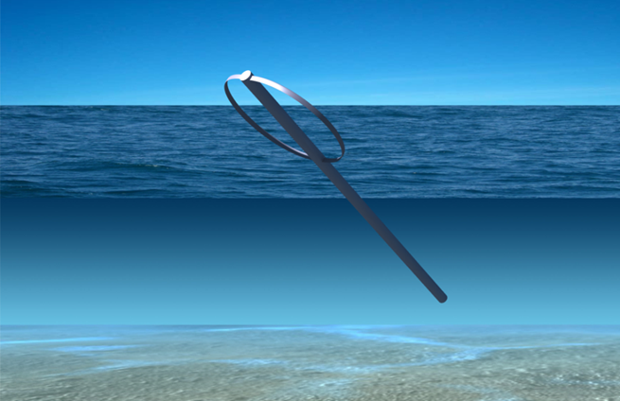
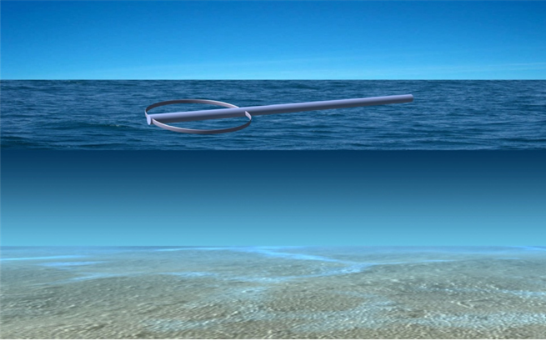
Installation at site
Counterweight(ballast) will make the turbine go into upright position.
ROVs and divers connect electrical cables with floating turbine.
At the site 1-3 service boats places the DeepWind turbine & 3-6 anchors with cables.
ROVs and divers connect and secure underwater lifting bags with turbine.

Slide 5
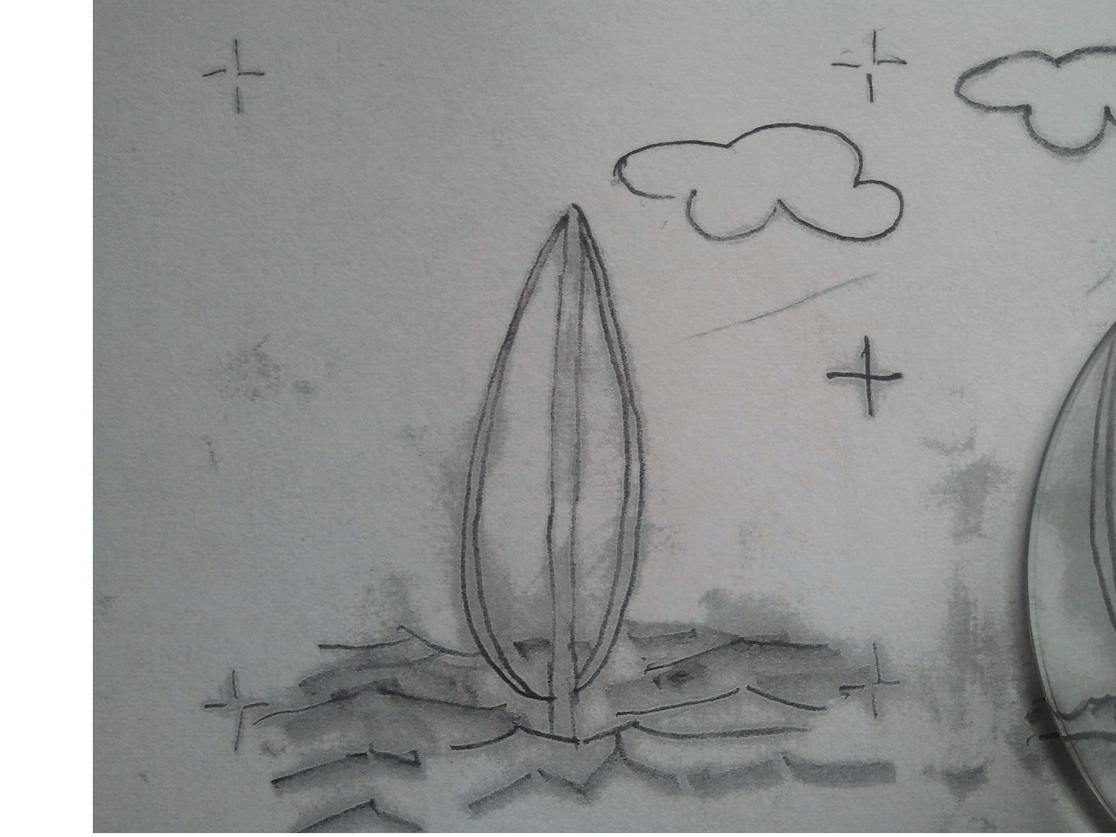
operation at site
Sites:
Asia, US, EC & the ‘Roaring 40th’
DeepWind produces 20GWh/yr at Western Coast of Norway.
Good for sites exposed to high wind in water of 100-1000 m depth.

Slide 6
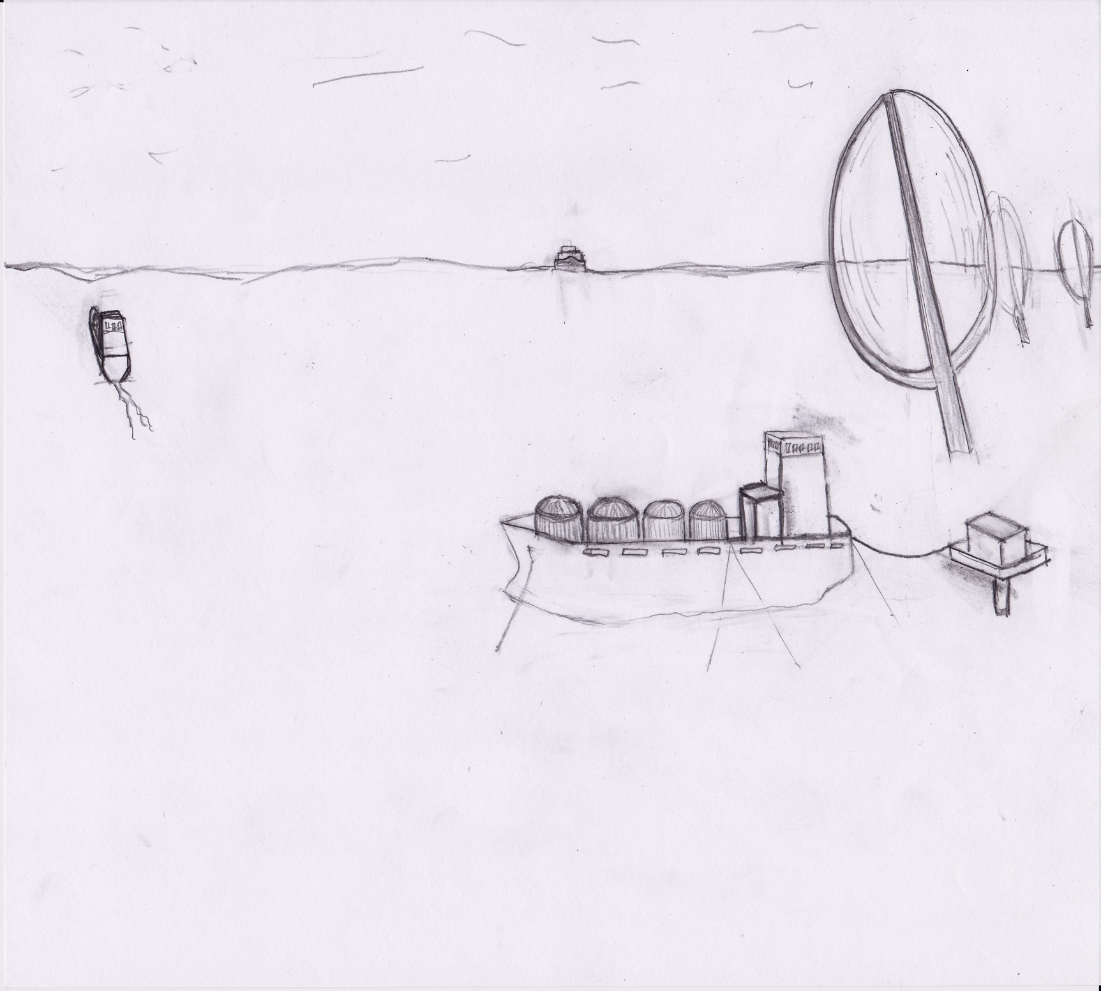
Utility operations
Battery driven (CO₂ emission free) ‘tankers’ charge their batteries.
After ‘fuelling’, the ships head for large cities, selling and delivering electricity in large battery banks.
The wind turbines are monitored remotely.
Autonomous ‘units’ survey and inspect the installations.

